Slide 1
Genetic effects on gene expression across human tissues - GTEx Genotype-Tissue Expression - HPA Human Proteome Atlas - ArrayExpress
Based on open source presentation and ELIXIR training resources

Slide 2
Motivation
understanding complex trait genetics
Majority of trait-associated variation is non-coding.
Common hypothesis is that most of these function by altering gene expression.
SNP
A

Slide 3
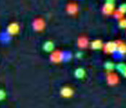
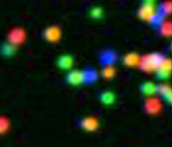
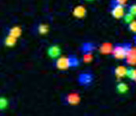
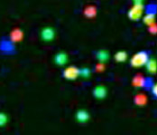
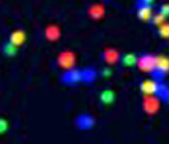
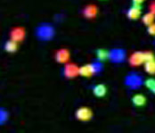
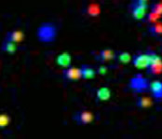
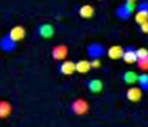
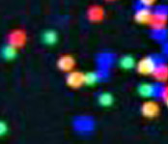
With the genomic revolution … RNA-Seq yields a snapshot of a full transcriptome
3’-
…-5’
5’-
G
T
A
T
T
T
T
C
G
G
C
A
C
A
G
A
G
A
C
T
T
G
T
C
T G C T A C G A T …
Sequential Base Calling
1
2
3
4
5
6
7
8
9
T T T T T T T G T …

Slide 4
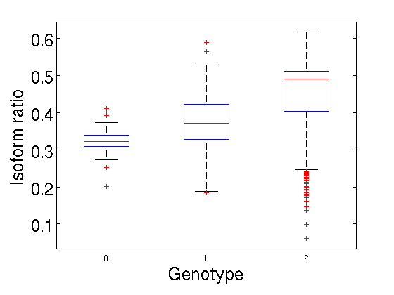
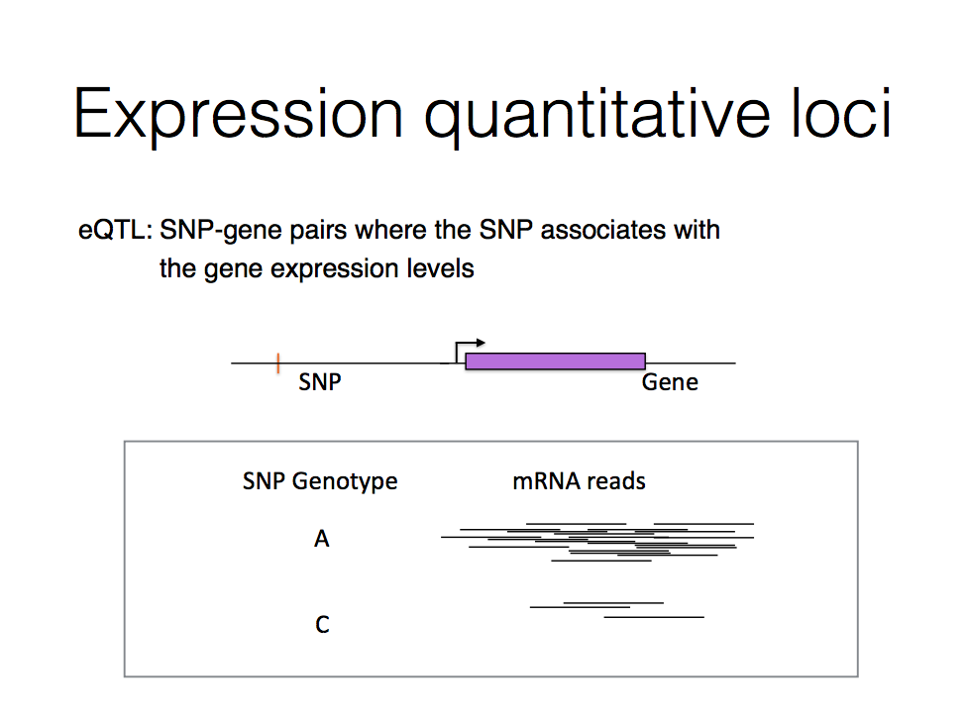
Genetic variants affect gene expression
eQTL (expression Quantitative Trait Locus) analysis:
Association between genotype and RNA expression levels
Expression of gene IKZF1
CC CA AA
SNP genotype at chr20: 5177528
Notes:
One approach for finding regulatory variants is to perform an eQTL study. For *common* genetic variants, we can simply look across a sample of individuals and directly test for association between genotype at the variant and expression of nearby genes, or even all genes.

Slide 5
GTEx
Project aim (started 2013)
To characterize human transcriptomes within and across a wide variety of primary tissues & cell types
449 human donors
44 tissues
Pilot phase: 1641 RNA-seq datasets
Consortium, GTEx. “Genetic Effects on Gene Expression across Human Tissues.” Nature News, Nature Publishing Group, 12 Oct. 2017, www.nature.com/articles/nature24277.

Slide 6
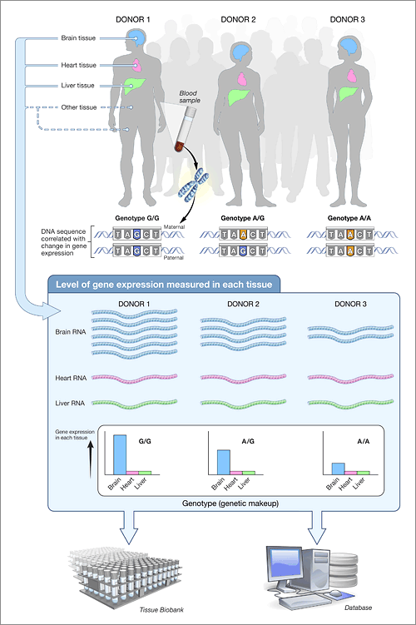
Gene expression & splicing resources
GTEx project - http://www.gtexportal.org/
Perform RNA-seq and genotyping for 43 tissues across hundreds of individuals
Pilot phase: 1641 RNA-seq datasets
Identification of eQTLs (SNPs that associate with expression)
The Genotype-Tissue Expression (GTEx) pilot analysis: Multitissue gene regulation in humans. Science (May 2015)

Slide 7
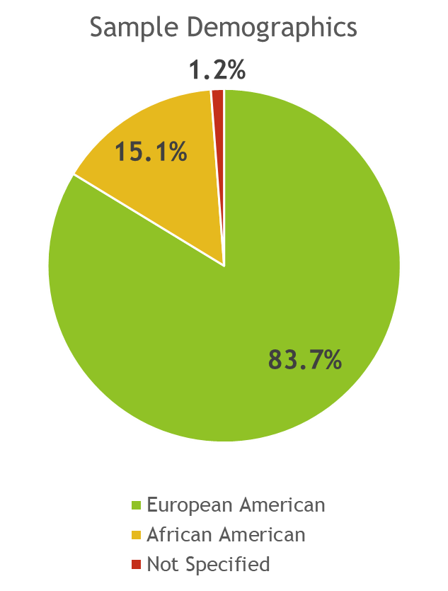
The nature of the samples
Accepted non-diseased tissue
Normal range for the age of donor
44 sampled regions/cell lines
Each from 70 donors
31 solid organ tissues
10 brain subregions
Duplicates of two regions (cortex and cerebellum)
Whole blood
Two cell lines derived from donor blood and skin samples
Sampled donors were 83.7% European American and 15.1% African American
Notes:
Sample was accepted for the project if it was non-diseased and in the normal range for the age of the donor
44 sampled regions or cell lines were considered
Each from 70 donors
31 solid organ tissues
10 brain subregions
Duplicates of two regions (cortex and cerebellum)
Whole blood
Two cell lines derived from donor blood and skin samples
Paper refers to these samples as “tissues”
Sampled donors were 83.7% European American and 15.1% African American

Slide 8
Aim of Study
Study across many tissues
Tissue-specific gene expression
Expression quantitative trait loci effects
Cis-eQTL
Trans-eQTL
Associates eVariants with gene expression levels
GTEx v6p release
Notes:
The study of tissue-specific gene expression and the identification of genetic associations with gene expression levels (or expression quantitative trait loci) across many tissues, including local (cis-eQTLs) and distal (trans-eQTLs) effects
This study associates genetic variants with gene expression levels from the GTEx v6p release

Slide 9
Genetic effects across human tissues
Total unique eQTL genes:
Cis: 19,725 (FDR 5%)
Trans: 93 (FDR 10%)
Most cis per tissue:
8,087 Tibial nerve (N=256)
Most trans per tissue:
35 Testis (N=157)
The GTEx Consortium, Nature 2017

Slide 10
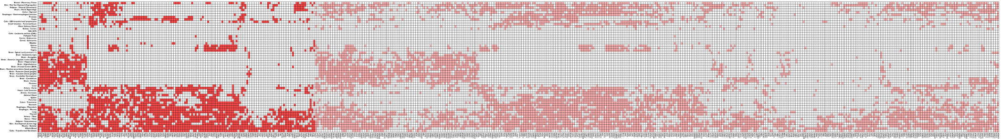
GTEx Project
GTEx Consortium v6p data
449 genotyped donors
7051 gene expression samples
42 post-mortem tissues
31 solid-organ tissues
10 brain subregions
44 tissues
116 individuals (WGS)
449 individuals (RNA-seq + genotype)
The GTEx Consortium, Nature 2017
Notes:
Since then, even more ambitious projects have evaluated the impact of genetic variation on gene expression in larger and more targetted studies.
I have been involved in the GTEx project for a number of years and recently co-led the analysis of eQTLs in the v6 release…

Slide 11
Example
Notes:
Sample was accepted for the project if it was non-diseased and in the normal range for the age of the donor
44 sampled regions or cell lines were considered
Each from 70 donors
31 solid organ tissues
10 brain subregions
Duplicates of two regions (cortex and cerebellum)
Whole blood
Two cell lines derived from donor blood and skin samples
Paper refers to these samples as “tissues”
Sampled donors were 83.7% European American and 15.1% African American

Slide 12
Cis-eQTLs
Association b/w eGenes and eVariants within 1Mb of the target gene’s TSS
All tissue:
152,869 found for 19,725 genes
Tibial nerve
8,087 eGenes in 256 samples
Notes:
Identified associations between eGenes and eVariants located within 1 Mb of the target gene’s transcription start site (TSS), cis-eQTLs
eGenes = expressed genes
eVariants = genetic variants
Throughout all tissues:
152,869 cis-eQTLs were found for 19,725 genes
The tissue with the highest number of identified cis-eGenes was the tibial nerve
8,087 eGenes in 256 samples

Slide 13
What else?
Allele-specific expression (ASE) analyses
Effect of cis-regulatory variation
Obtained by measuring the allelic imbalance of RNA-seq reads at transcribed heterozygous sites
sGENE Tissue specific alternative splicing products (version 8)
Notes:
Methods performed:
Applied a linear model – controls for ancestry, sex, genotyping platform and latent factors in the expression data for each tissue that may reflect batch or other technical variables
Throughout all tissues:
152,869 cis-eQTLs were found for 19,725 genes
To identify cis-eGenes affected by more than one functional regulatory variant, forward-backward stepwise regression was applied
Identified an additional 24,886 secondary cis-eQTLs
Effect of cis-regulatory variation can also be quantified by allele-specific expression (ASE) analyses
Obtained by measuring the allelic imbalance of RNA-seq reads at transcribed heterozygous sites

Slide 14
Unification of Genomics and Transcriptomics
Simple diseases are described at a gene level
Many of the diseases are dose dependent (e.g., Diseases of Chr-X affecting male only)
Many biological processes are described
- at the Molecular level
- at the Cellular level
- at the Tissue level
- at the Organ level
- at the Organism level

Slide 15
General resources for getting expression data
GEO (NCBI Gene Expression Omnibus)- http://www.ncbi.nlm.nih.gov/geo/ ,
SRA (Sequence Read Archive) - http://www.ncbi.nlm.nih.gov/sra ,
ENA (European Nucleotide Archive) - http://www.ebi.ac.uk/ena
dbGAP - http://www.ncbi.nlm.nih.gov/gap
Controlled-access version (for data with genotype/personally identifiable information)
Illumina Body Map - http://www.ebi.ac.uk/arrayexpress/experiments/E-MTAB-513/
Basic RNA-seq dataset of 16 human tissues

Slide 16
Future Implications for GTEx
Increased sample size
A goal of ~1,000 donors , 50 tissues
Both computational and experimental methods
Meta- and single-tissue analyses jointly
Inclusion of genomic annotations
Notes:
Future applications:
one strategy for increasing power in studies of inaccessible or sample-limited cell types would be to analyze meta- and single-tissue analyses jointly with data from GTEx tissues
inclusion of genomic annotations (enhancers, promoters, and distance to TSS) increased the total number of cis-eQTL discoveries by an average of 43% (or 1,200 genes) per tissue
future application: this demonstrates the considerable advantage of integrating genomic annotations into eQTL mapping models
Future application: Expect trans-eQTL discoveries to increase with additional samples in the final phase of GTEx
Future application: both computational and experimental methods, such as deconvolution methods and single-cell sequencing as part of the proposed Human Cell Atlas and related projects, promise to improve resolution to identify precise cell type-specific regulatory effects
Future aims of the GTEx project include increased sample size
Plans to include approximately 1,000 donors in the final data release

Slide 17
Illustration of GTEX
Notes:
Future applications:
one strategy for increasing power in studies of inaccessible or sample-limited cell types would be to analyze meta- and single-tissue analyses jointly with data from GTEx tissues
inclusion of genomic annotations (enhancers, promoters, and distance to TSS) increased the total number of cis-eQTL discoveries by an average of 43% (or 1,200 genes) per tissue
future application: this demonstrates the considerable advantage of integrating genomic annotations into eQTL mapping models
Future application: Expect trans-eQTL discoveries to increase with additional samples in the final phase of GTEx
Future application: both computational and experimental methods, such as deconvolution methods and single-cell sequencing as part of the proposed Human Cell Atlas and related projects, promise to improve resolution to identify precise cell type-specific regulatory effects
Future aims of the GTEx project include increased sample size
Plans to include approximately 1,000 donors in the final data release

Slide 18
Expression via proteins HPA
Harder task
Cross reactivity is unavoidable
Quantitation is limited
BUT, really important for cellular localization, cancer and diseases
Discrepancy between mRNA and protein (stability/ decay/ miRNAs,…)
Combined with RNA-Seq – high quality
Notes:
Future applications:
one strategy for increasing power in studies of inaccessible or sample-limited cell types would be to analyze meta- and single-tissue analyses jointly with data from GTEx tissues
inclusion of genomic annotations (enhancers, promoters, and distance to TSS) increased the total number of cis-eQTL discoveries by an average of 43% (or 1,200 genes) per tissue
future application: this demonstrates the considerable advantage of integrating genomic annotations into eQTL mapping models
Future application: Expect trans-eQTL discoveries to increase with additional samples in the final phase of GTEx
Future application: both computational and experimental methods, such as deconvolution methods and single-cell sequencing as part of the proposed Human Cell Atlas and related projects, promise to improve resolution to identify precise cell type-specific regulatory effects
Future aims of the GTEx project include increased sample size
Plans to include approximately 1,000 donors in the final data release

Slide 19
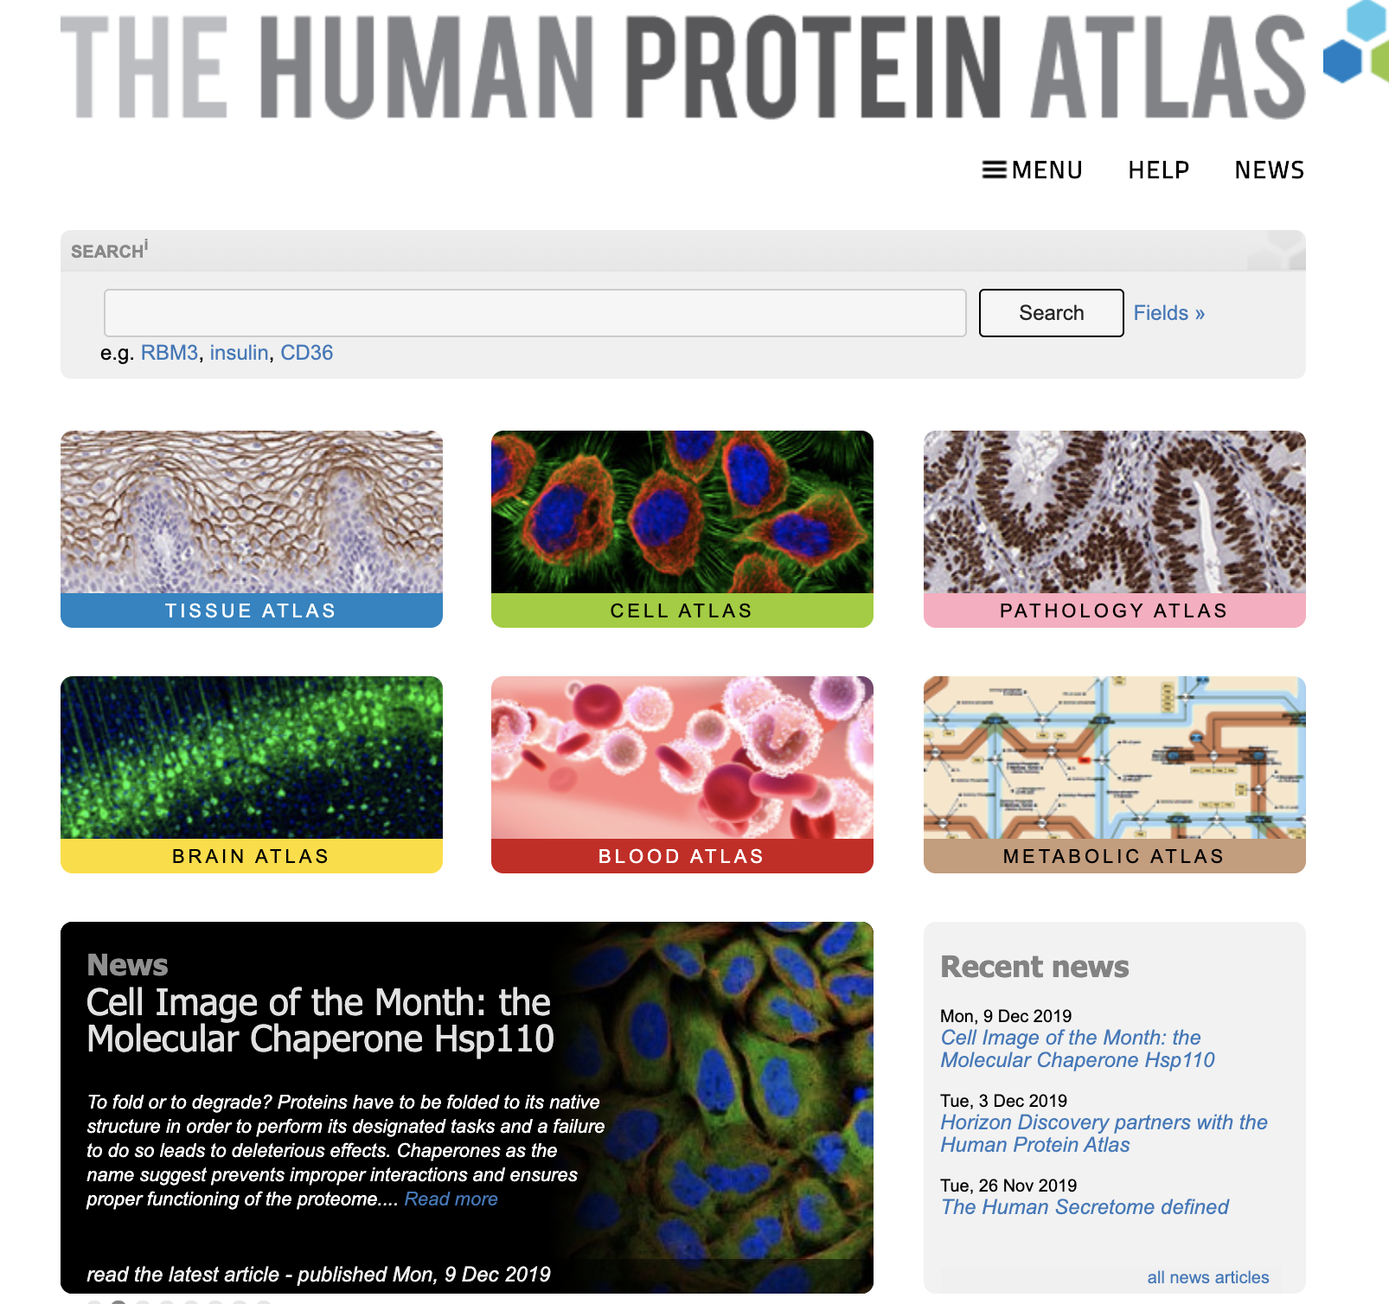
Notes:
Future applications:
one strategy for increasing power in studies of inaccessible or sample-limited cell types would be to analyze meta- and single-tissue analyses jointly with data from GTEx tissues
inclusion of genomic annotations (enhancers, promoters, and distance to TSS) increased the total number of cis-eQTL discoveries by an average of 43% (or 1,200 genes) per tissue
future application: this demonstrates the considerable advantage of integrating genomic annotations into eQTL mapping models
Future application: Expect trans-eQTL discoveries to increase with additional samples in the final phase of GTEx
Future application: both computational and experimental methods, such as deconvolution methods and single-cell sequencing as part of the proposed Human Cell Atlas and related projects, promise to improve resolution to identify precise cell type-specific regulatory effects
Future aims of the GTEx project include increased sample size
Plans to include approximately 1,000 donors in the final data release

Slide 20
Illustration of HPA
Notes:
Future applications:
one strategy for increasing power in studies of inaccessible or sample-limited cell types would be to analyze meta- and single-tissue analyses jointly with data from GTEx tissues
inclusion of genomic annotations (enhancers, promoters, and distance to TSS) increased the total number of cis-eQTL discoveries by an average of 43% (or 1,200 genes) per tissue
future application: this demonstrates the considerable advantage of integrating genomic annotations into eQTL mapping models
Future application: Expect trans-eQTL discoveries to increase with additional samples in the final phase of GTEx
Future application: both computational and experimental methods, such as deconvolution methods and single-cell sequencing as part of the proposed Human Cell Atlas and related projects, promise to improve resolution to identify precise cell type-specific regulatory effects
Future aims of the GTEx project include increased sample size
Plans to include approximately 1,000 donors in the final data release

